Slide 1
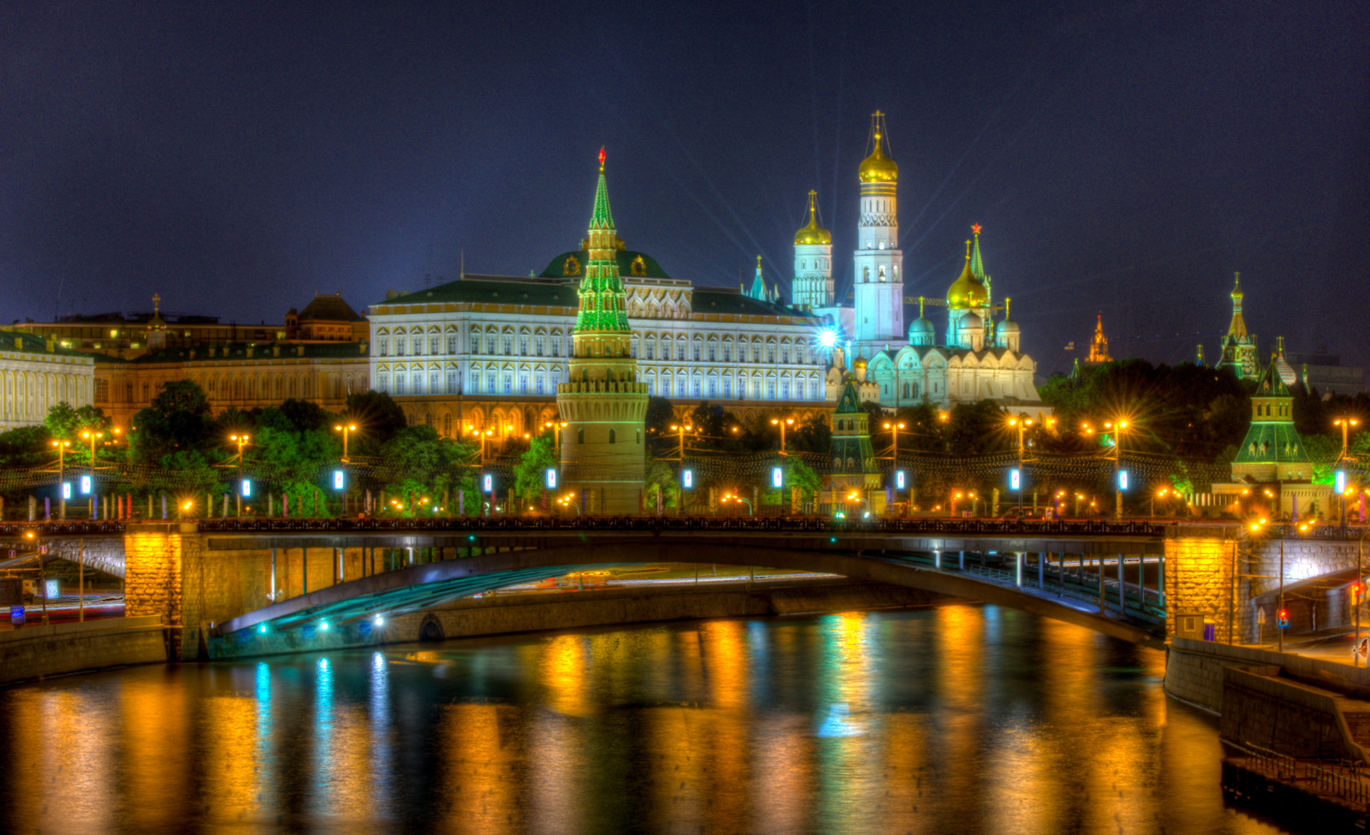
Russian Federation
Case Study 2

Slide 2
Russia
Government Basics
Government
A presidential democracy on paper that functions in reality like an authoritarian regime
Federal Govt
Government centralized in Moscow
There are 83 subnational governments with varying degrees of power.

Slide 3
Russia
Geography
Land
Largest European country in population and in land mass
Largest country in the world
Spans 11 different time zones
Less than 8% of all land is arable.
Rich in natural resources, but they are concentrated in the north & western Siberia
73% of Russians now live in urban areas

Slide 4
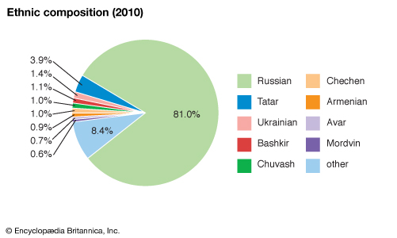
Russia
Demographics
Ethnic breakdown of people living in Russia

Slide 5
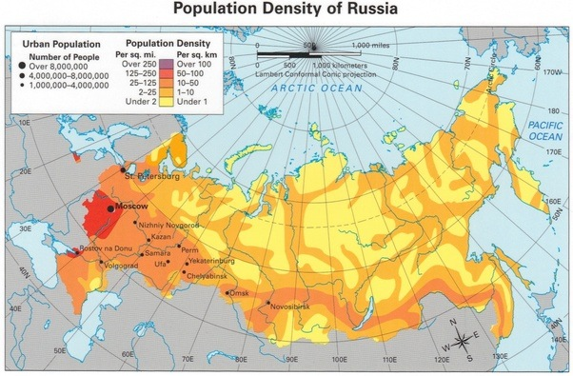
Russia
Demographics

Slide 6
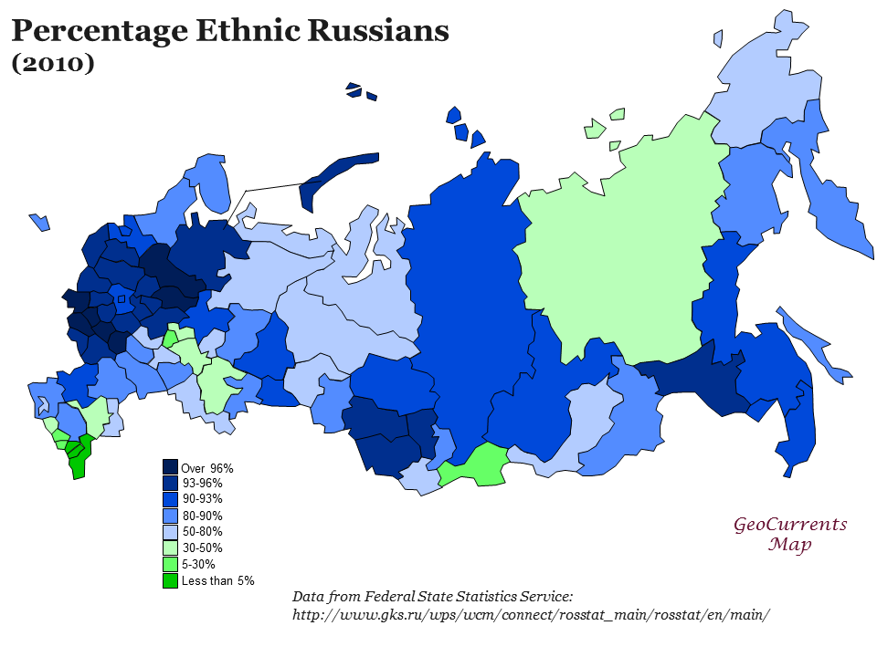
Russia
Demographics

Slide 7
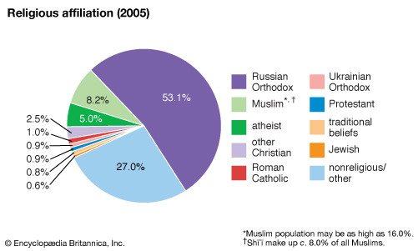
Russia
Demographics
Lots of discrepancy in counting the number of Muslims

Slide 8
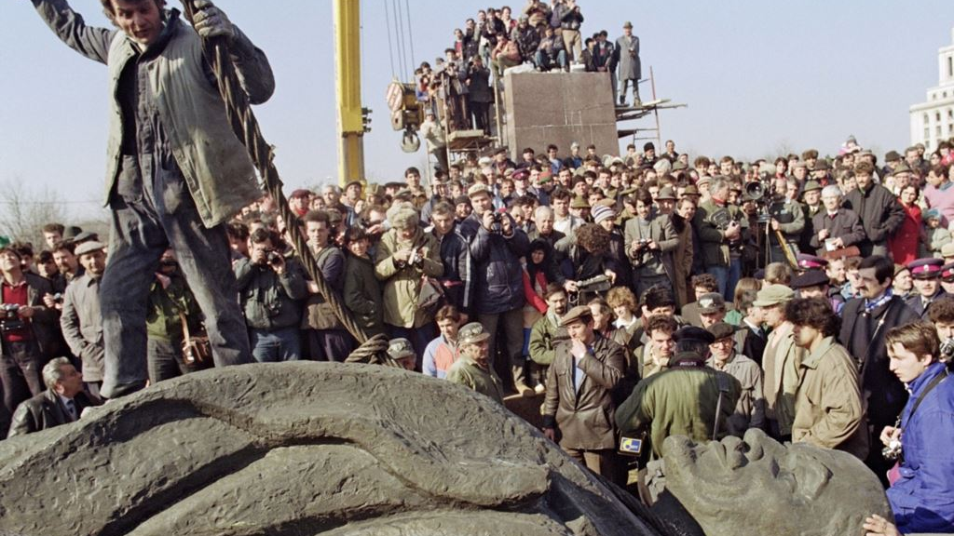
Development of the State
Russia

Slide 9
Russia
Critical Junctures
Pre 1917
Was an autocratic tsarist state until 1917. The state ruled the country and owned all the land
Peasant population were tied to nobles, which were tied to the state. Serfs were emancipated in 1861.
The state drove efforts to modernize and industrialize
Revolution attempts in 1905 were suppressed & the tsar maintained power until World War 1 began

Slide 10
Russia
Critical Junctures
1917 Revolution
Vladimir Lenin was sent into Russia by Germans. He began a revolution based on interests of proletariat
Bolsheviks formed the USSR in 1922 after a long civil war. As they built govt. centralization took precedence over democratic elements.
Joseph Stalin came to power following the death of Lenin in 1924.
This revolution also caused a period of international isolation

Slide 11
Russia
Critical Junctures
Stalin Revolution
Stalin ruled from 1929-1953, consolidating his power throughout
State drove economic development and owned all economic assets. Collectivization led to famine.
Political opposition was eliminated & state controlled media & the arts.
Under Stalin, USSR involvement in WW2 allowed empire to expand into Eastern Europe and emerged as a global superpower

Slide 12
Russia
Critical Junctures
Collapse of USSR
In 1991 Boris Yeltsin was elected president of the Russian Republic – a part of the USSR
A conservative coup was attempted to halt Gorbachev’s reforms
While Gorbachev was held captive, Yeltsin and other leaders declared an end to the USSR
Yeltsin proclaimed his commitment to Western style democracy and market economy in an independent Russia

Slide 13
Russia
Critical Junctures
Vladimir Putin
Yeltsin appointed Putin prime minister in 1999. He won the presidency the next year when Yeltsin resigned.
A sustained period of economic growth began around the same time
After serving two terms as president, Putin was unable to run again so endorsed Dmitry Medvedev who won easily in 2008.
In 2012, Putin was able to run for president again and won easily.

Slide 14
Russia
Themes
International influence
Russia has reasserted itself as an important player in international affairs under the leadership of Putin
Has difficulty establishing itself as a respected world leader
When they act, they are likely to face opposition from international coalitions.
Russia struggles to find steady allies, is not a member of NATO

Slide 15
Russia
Themes
Economic performance
The first decade after USSR collapse was marked by steady economic decline
After 1998 growth returned, govt generated steady surpluses
The 2008 financial crisis and dropping oil prices posed challenges for the government

Slide 16
Russia
Themes
Democracy?
Reforms adopted after 2000 have undermined political competition
There are widespread concerns about the future of Russian democracy
United Russia, Putin’s party, is the dominant political party and faces little real competition
Corruption is widespread

Slide 17
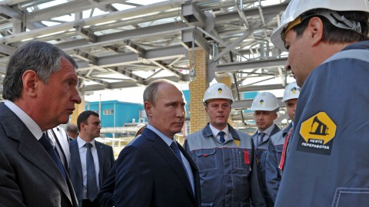
Economic Policy
United Kingdom

Slide 18
Russia
State & Economy
End of Communism
Collapse of USSR radically reduced the state’s role in economic development
This brought an immediate dramatic decline in economic performance
Unprecedented depression from 1991 - 1998
This went along with a decline in the prices of oil and natural gas, which drives a good bit of Russia’s economy

Slide 19
Russia
State & Economy
Market Reforms
In the USSR, all assets belonged to the state. Prices were controlled.
Yeltsin began market reforms in 1992.
End price controls
Encourage entrepreneurships
Privatizing state owned industries
Encouraging foreign investment

Slide 20
Russia
State & Economy
Privatization
Privatization took place very quickly, compared to other post communist states
State enterprises were privatized by turning them into joint stock companies
Insider privatization allowed managers and workers to acquire ownership of where they worked at made up prices
Each citizen was given a privatization voucher to buy shares in a company
The people who ended up in control were not prepared to operate in a market economy

Slide 21
Russia
State & Economy
Privatization
By 1995 firms were allowed to sell shares for cash or investment guarantees
Successful companies were grabbed by successful financial firms
This caused acceleration of more and more of the market being concentrated in the hands of few connected people
These oligarchs, who were the few that benefitted from privatization, now have significant political influence

Slide 22
Russia
State & Economy
Weak Institutions
State was unable to collect taxes efficiently, so it lacked revenue
Without revenue, the state was unable to provide services to the population
The state was unable to fight crime, so many businesses turned to the mafia for protection
Lack of capacity of the govt encouraged corruption and crime

Slide 23
Russia
State & Economy
Debt
Bad finances caused the government to begin taking out more loans
New loans had progressively higher interest rates to pay the old debts
This pyramid debt structure caused Russian stock market to collapse and the govt defaulted on its bonds
They printed more rubles, devaluing the money

Slide 24
Russia
State & Economy
Recovery
The devalued ruble actually made Russian products more competitive
Firms improved and productivity began to increase
This created more revenue which increased state capacity

Slide 25
Russia
State & Economy
Putin’s Reforms
He imposed a 13% flat tax.
Significant deficits turned into budget surpluses
He said he would impose sanctions on oligarchs that used their positions to impact politics, but he only punished those who were critical of his govt.

Slide 26
Russia
Society & Economy
Soviet Govt
USSR leadership did not get input from society to establish priorities
The regime did accomplish many social goals.
There was free universal health care
Low cost essential goods & services
Education for all led to universal literacy
Guaranteed employment & job security

Slide 27
Russia
Society & Economy
Soviet problems
Soviet system was plagued by shortages and low quality services
There were housing shortages that prevented people from moving
There was no economic incentive for innovation or outstanding achievements
This led to Russians to expect the state to ensure a social welfare network, so they were unprepared for cutbacks in the 1990s

Slide 28
Russia
Society & Economy
Market reforms
Some benefitted from market reforms much more than others
People who gained positions in banking, finance, oil, and gas tend to be among the super wealthy
Those in natural resources or with Western language skills are better off
Young people adapted to new work environments better than older people, who were stuck in Soviet mindsets.

Slide 29
Russia
Society & Economy
Under Putin
Level of personal consumption are rising among Russians
Putin has prioritized improvement in health care, education, housing, and agriculture
He doubled the monthly child support payments to encourage more children in order to fight declining populations

Slide 30
Russia
Global Economy
Foreign Assistance
Western countries made commitments of technical and humanitarian aid in the 1990s
Substantial assistance has come from the World, Bank, the IMF, and the EU
Russia has had problems attracting foreign investment, but there has been significant FDI from Germany & USA
Foreign investors are prevented from gaining a majority share in sectors of the economy identified as being strategically important.

Slide 31
Russia
Global Economy
Trade
Trade priorities have shifted
In the early 1990s it’s most important trading partner was Ukraine.
In 2008, Germany was the largest trading partner, followed by the Netherlands, and Italy
Focus has shifted from Eastern Europe to Western Europe
China is the largest source of Russian imports
Russia exports a lot of energy resources to European Union countries

Slide 32
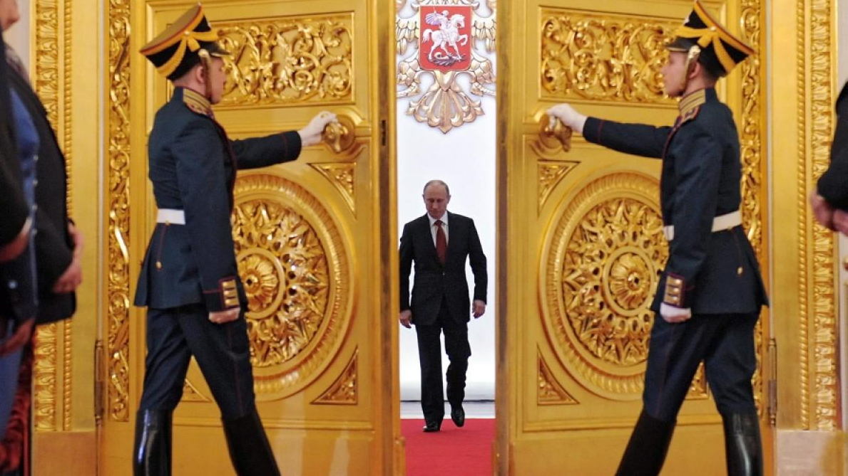
Governing & Administration
United Kingdom

Slide 33
Russia
Executive
Executive
The constitution creates a semi presidential system
There’s a president and a prime minister
The prime minister is appointed by the president but is approved by the Duma
The president is the head of state and the prime minister is the head of government.
The president is in charge of foreign policy and the prime minister focuses on the economy.

Slide 34
Russia
State Organization
Presidency
The position was created in 1991.
It’s elected by direct popular vote
The constitution makes the executive dominant, but still dependent on the legislative branch to realize policy goals
Executive powers have expanded under Putin, who has undermined checks and balances and centralized authority

Slide 35
Russia
Executive
President
The constitution prevents the same person from being president for three consecutive terms.
The president can issue decrees, which cannot violate the constitution or legislation passed by the Duma
This allows the president to ignore an uncooperative legislature
The president is commander in chief of the military and handles diplomacy

Slide 36
Russia
Executive
President
The president can call a state of emergency
Can impose martial law
Can temporarily suspend actions of other state organs
These powers make it easy for the president to use emergencies to increase his powers

Slide 37
Russia
Executive
Prime minister
The prime minister will fill in for the president if he dies, until new elections can be held.
The president’s choice of prime minister must be approved by the Duma
The prime minister can be removed by the Duma after two votes of no confidence within a 3 month period.
The prime minister is not necessarily a member of the majority party
When Putin was PM, the PM was the leader of the dominant party.

Slide 38
Russia
Bureaucracy
Bureaucracy
State administration structure includes ministries, state committees, and agencies.
Ministries are mostly concerned with policy functions
Agencies deal with monitoring functions and implementation
Ministries like Foreign Affairs Ministry and Defense Ministry report directly to the president.

Slide 39
Russia
Bureaucracy
Bureaucracy
The president created advisory bodies to give input from political and economic actors in order to co-opt them into supporting govt policies
The Security Council advises the president about foreign policy and includes heads of some ministries
The State Council advises the president about regional issues
The ministers do not have to be approved by parliament and are generally career bureaucrats instead of political figures

Slide 40
Russia
Bureaucracy
Bureaucracy
Some economic sectors are still either public or semi public
Telecommunications, public transportation, electronic media, and energy are public or semi public
Gazprom is the state monopoly on natural gas
Other sectors like education and health care are supported by taxes.
There is a state run system to provide medical care, but also private hospitals are increasing

Slide 41
Russia
Other Institutions
Military
Security establishment has become more powerful under Putin
The military has shrunk to a quarter of its size at the end of the USSR
Defense spending is increasing but is still far below Soviet levels.
Political power and prestige of the military have decreased
Private security firms are expanding becase of high crime rates

Slide 42
Russia
Other Institutions
Judiciary
Judicial independence and rule of law were not important in Soviet Russia
The implementation of these concepts has not been very successful
Constitutional Court has power to settle disputes between the federal and regional laws, and between various political institutions
The court does not really confront the executive branch
There’s also lower and appellate courts that feed into a Supreme Court for regular civil and criminal cases

Slide 43
Russia
Subnational
Subnational Governments
Putin has implemented a system called the power vertical
This created 7 federal districts on top of the existing federal units.
These oversee the work of federal offices in these regions
The election of governors has been eliminated. They are now nominated by the president and approved by the regional legislation
Governors and regional presidents are not dependent on having good relations with the president.

Slide 44
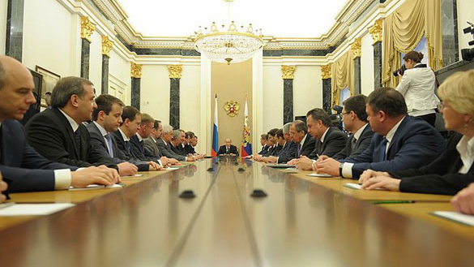
Policy Making
United Kingdom

Slide 45
Russia
Policy Making Process
Policy Making Process
The constitution allows the president, regional legislatures, deputies, and judicial bodies can propose legislation
Yeltsin had conflicts with the Duma, but under Putin, the Duma has generally gone along with the president
Policy increasingly comes from the executive branch.

Slide 46
Russia
Policy Making Process
Policy Making Process
Bills have to be approved by both houses of the Parliament
The president approves any bills passed by the legislature.
The president can veto laws and legislature can override the veto with a two thirds majority in both houses
The president is increasingly making policy through issuing decrees.
Policy implementation is very difficult and not done well.

Slide 47
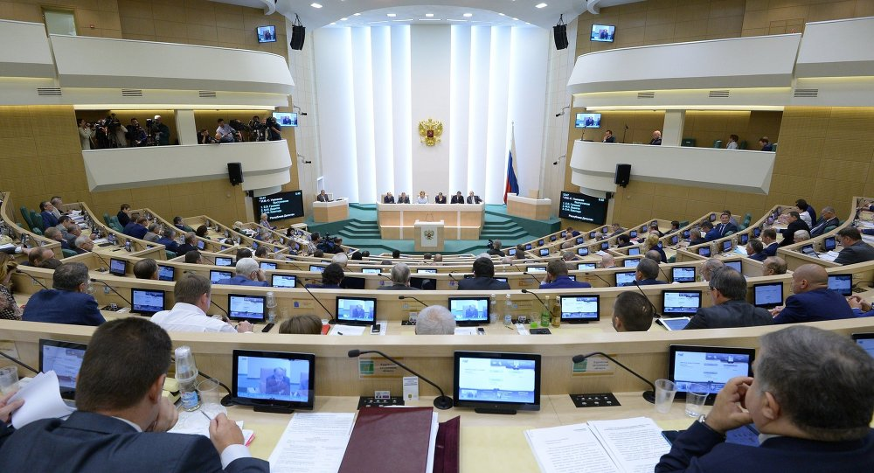
Representation
United Kingdom

Slide 48
Russia
Legislature
Federal Assembly
A bicameral legislature created in 1993
Upper house is the Federation Council which represents federal units
Lower house is the State Duma which represents the people
Both must agree on legislation in order for it to pass.
Deputies from both houses are granted immunity from criminal prosecution

Slide 49
Russia
Legislature
Federal Assembly
In the early 1990s, parliament confronted Boris Yeltsin often
Since 2003, parliament has mostly cooperated with the president
About 2/3 of the members have ties to United Russia, Putin’s party.
Parties in parliament are isolated from the public, suffer low levels of popular respect, and are dominated by the elite

Slide 50
Russia
Legislature
Duma
450 members that are directly elected based on proportional representation
The Duma is controlled overwhelmingly by the dominant party, United Russia
It elects its own leadership, the speaker is from majority party
32 committees are made from among the Duma to do the work of legislating

Slide 51
Russia
Legislature
Duma
Women and workers are underrepresented in the Duma
In 1984, 1/3 of members were women, that was less than 10% by 2005.

Slide 52
Russia
Legislature
Federation Council
Has two members from each of Russia’s federal regions & republics
Its members are appointed, and often in exchange for political loyalty
Parties do not play a major role in the Federation Council

Slide 53
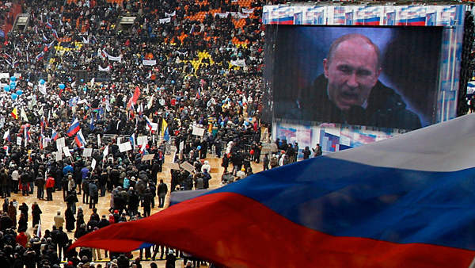
Participation
United Kingdom

Slide 54
Russia
Political Parties
Old Party System
Most important political change has been the shift from a one party system under Soviet rule to a multi party system
The Communist Party dominated the state, but also the media, unions, education, and professional associations
10% of all adults were party members, but there was nothing to make the party accountable to the people
National elections were held for the first time in 1989, but new parties did not participate until 1993.

Slide 55
Russia
Political Parties
Party Spectrum
Parties do not fit neatly on a left-right political spectrum
The traditional left, critical of market reforms, and mildly nationalistic
Liberal/reform parties, support Western style market reform & political norms
Centrist parties of power represent the political elite of Russia
Nationalist/patriotic parties primarily focus on identity issues and nationalism

Slide 56
Russia
Political Parties
United Russia
United Russia has dominated Russian politics since 2003.
It rose to prominence with Putin in elections in 1999 and 2000.
In 2008 they made the position of party chairman for Vladimir Putin
United Russia is the main source of political support for Putin
The party is essentially a political machine that controls regional elites

Slide 57
Russia
Political Parties
United Russia
The party is focused on winning prominent people’s support.
It is centrally controlled and gains control over the regions because Putin has the power to appoint the governors
The party does not really present a platform or program of legislation

Slide 58
Russia
Political Parties
Communist Party
The only party that could be considered an opposition force
Its strength has steadily declined since the elections of the early 1990s.
Its goals are democracy, justice, equality, patriotism, internationalism, and socialist renewal, but not really advocating a return to communist govt
Supported mostly by older Russians, the economically disadvantaged, and rural Russians – those who have adapted less successfully to changes.
It has been unable to find a likeable political leader or support from the young

Slide 59
Russia
Political Parties
Liberal Democratic Party
It’s not really liberal or democratic!
Its populist and nationalist and it appeals to anti-western sentiments
It gets its support from working class men and from some military personnel

Slide 60
Russia
Political Parties
A Just Russia
Brought a few smaller parties together under one larger party
May be kind of a fake party.
People think it was formed just so that there could be proof of real competition in Russia’s election
It shows competition exists while undermining the other opposition parties that could threaten United Russia

Slide 61
Russia
Political Parties
Liberal reform parties
These parties have been marginalized since 2003.
They’ve changed party names over and over.
They are committed to liberal values, such as limited economic role for the state, support for free market, and protection of individual liberties
People reject their ideas because of how these ideas worked out in the 90s
Since they haven’t run under a consistent party name, they haven’t been able to attract a real following

Slide 62
Russia
Elections
Elections
Turnout his usually between 60% & 70%
Political leadership wants turnout to be high so elections appear legitimate.
The Duma is elected by proportional representation for parties that get at least 7% of the votes
Parties must also have affiliates in more than half of the regions of Russia
Media coverage favors United Russia and there has been no real transfer of power so does not appear democratic

Slide 63
Russia
Political Culture
Political Culture
Tsarist period attitudes have tremendous influence on political culture
There’s a tradition of personalistic authority
Russians expect highly centralized leadership.
The 1990s brought Western political ideas, but people are skeptical of “imported culture”
Putin has introduced the concept of sovereign democracy, emphasizing the importance of adapting democracy to Russian traditions and conditions instead of Western models.

Slide 64
Russia
Political Culture
Ethnicity
Soviet Union was only 50% Russian, but many ethnic minority states broke away
Russians make up 80% of the population now.
Largest minority group is Tartars, a Muslim group. Other Muslims are concentrated in the northern Caucus region
Russian nationalism is contributing to a rise in anti-Semitism and anti-Muslim attitudes.

Slide 65
Russia
Political Culture
Religion
Russian Orthodox Christianity is the dominant religion
A 1997 law made it harder for new religious groups to organize in Russia
This impacted mostly Western religions that were beginning to organize in Russia after the dissolution of the USSR
Russian Orthodox Church pushed for this law and it helps them maintain a privileged status in Russia

Slide 66
Russia
Political Culture
Women
Gender roles tend to reflect traditional family values.
Feminism is not popular or part of accepted social roles for women
Women in media are likely to be portrayed as sex objects.
Increasing numbers of young women are turning to prostitution

Slide 67
Russia
Political Culture
Social Class
Social class was a dominant theme in Soviet Russia.
In postcommunist Russia, people do not trust politicians who claim to represent the working class.
Unions are not supported
Even the Communist Party does not express itself as advocating for the working class

Slide 68
Russia
Political Culture
NGOs
In 2006 Putin made laws that denied many new public organizations
Existing ones have to report to the government, especially if they get money from foreign sources
The government can monitor the actions of these groups
This was justified as necessary to stop terrorist threats.
Govt tries to channel public activism through official forums

Slide 69
Russia
Political Culture
Public Chamber
In 2001 the Civic Forum was organized and in 2005 the Public Chamber was added
These allow the public to consult and give input to the government about policies and political issues
This allows the government to co-opt public activists from more disruption
This does allow citizens to interact with the government and express their desires, but in a way that is controlled by the government

Slide 70
Russia
Political Culture
Media
TV coverage is subject to direct influence from the government
Newspapers & independent journalists, and some independent sources are critical of the govenrment
52 journalists have been murdered since 1992 (according to the text)
More outlets are controlled by industrial groups close to Putin. Independent media sources have declined dramatically
Russia ranks 140th of 178 in ranking of press freedom.

Slide 71
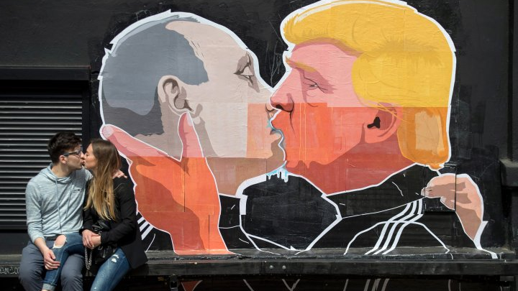
Developing Political Issues
United Kingdom

Slide 72
Russia
Current Challenges
International Role
Moscow resents Western dominance & is relatively powerless in affecting global developments (*text)
Relations with the West got slightly better when they worked together to fight against terrorism
They have been unable to reestablish themselves as a regional leader in neighboring countries, like Ukraine
They are not seen as an equal partner with the United States and Europe

Slide 73
Russia
Current Challenges
Economy
Cooperation with the West will be important economically, because they will need the West to reach potential
Especially in natural gas extraction, Russia needs Western investment & technical knowledge to meet demands and export commitments
Drops in gas prices after 2008 hurt the Russian govt which relies on income from natural gas exports
Energy prices recovered quickly & they had a big reserve built up, so it did not cripple the economy this time, but prolonged decreases could.

Slide 74
Russia
Current Challenges
Democracy?
Moving more toward authoritarianism hurts its relationship with the West
Putin’s consolidation of control has severely limited political competition
The lack of established civil society makes it easy for politicians to use emotional appeals & nationalism

Slide 75
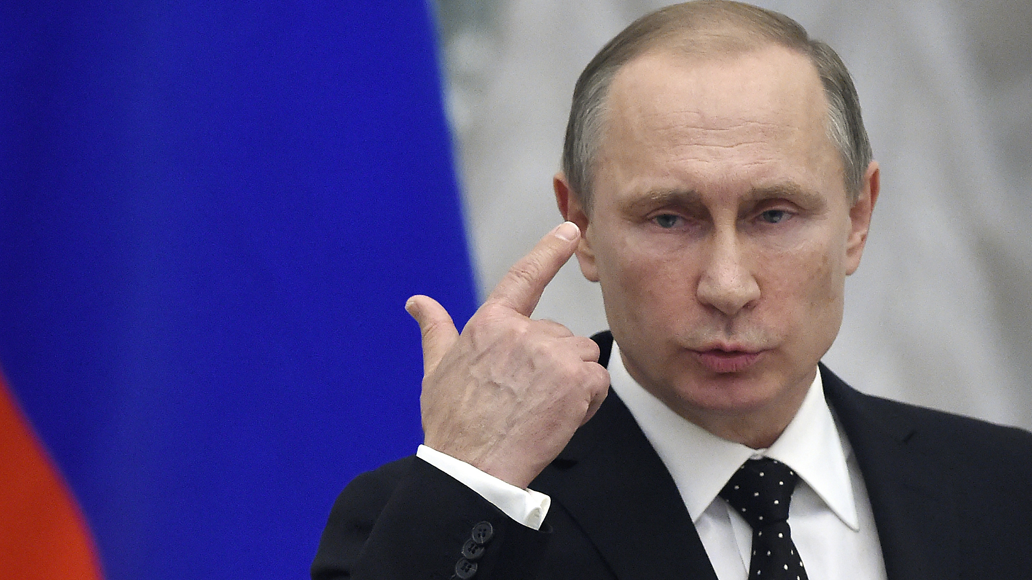
Keep knowledge here.
Russia

Slide 76
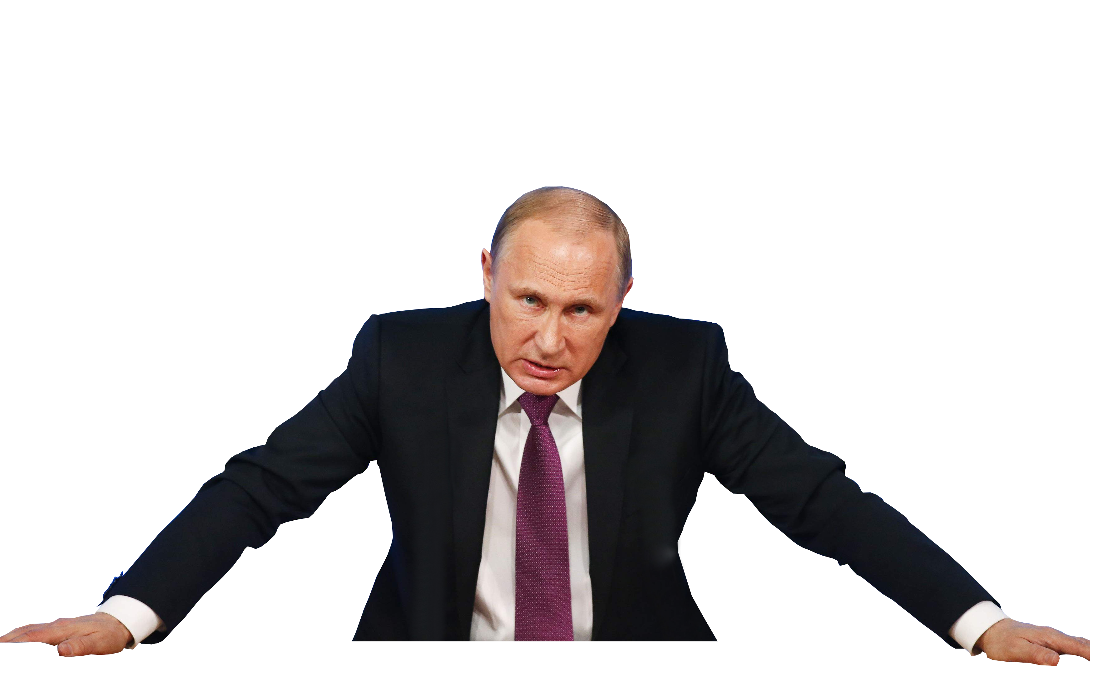
Main Ideas
Russia
Privatization
Liberalism
Europe or American oriented FP
Putin’s Pointers!
Devolution

